Slide 1
NLOS Updates Dec 18, 2025

Slide 2
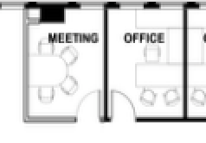
Asset Accuracy_ Single Data Paket
 | Beacon Placement | Algorithms | Zones with a Beacon Installed |  |  | Zones without a Beacon Installed
 |  |  | Room | Open Areas | Overall | Room | Open Areas | Overall
Cognosos | Beacon installed at Zone Center (Precise Coordinate Measurement) | NLOS | 89 % | 83 % | 86 %
 |  | NLOS_LocAI Hybrid | 93 % | 85 % | 89 %
 |  | LocAI | 93 % | 85 % | 89 %
Edge Case: Tags were placed near the borders, under the shelf/ desk.. |  | NLOS | 85 % | 82 % | 84 %
 |  | NLOS_LocAI Hybrid | 87 % | 82 % | 85 %
 |  | LocAI | 86 % | 76 % | 83 %
UVA | Beacon installed at Zone Center (Imprecise Coordinate) | NLOS | 90 % | 83 % | 87 % | 64 % | 54 % | 56 %
 |  | NLOS_LocAI Hybrid | 92 % | 84 % | 89 %
 |  | LocAI | 94 % | 89 % | 92 % | 92 % | 86 % | 89 %
Tag

Slide 3
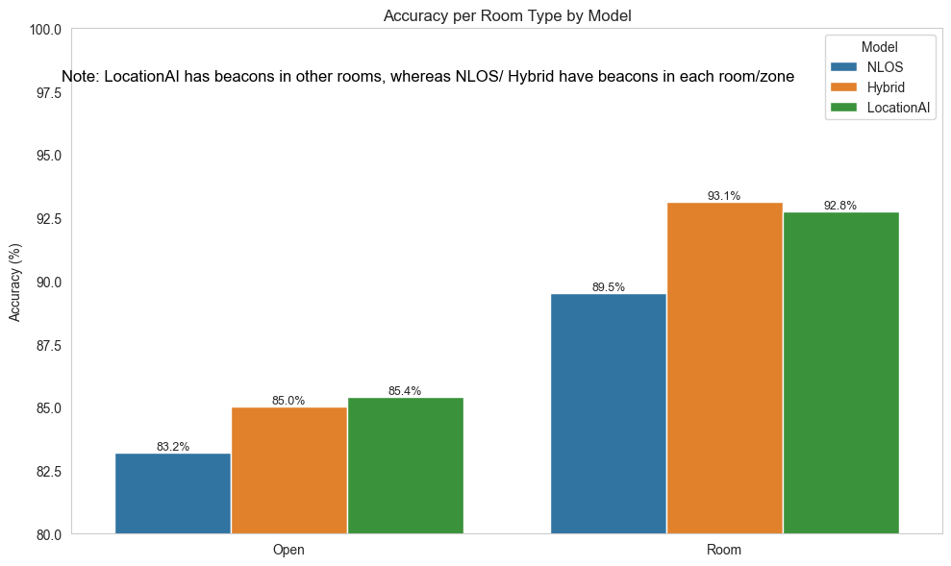
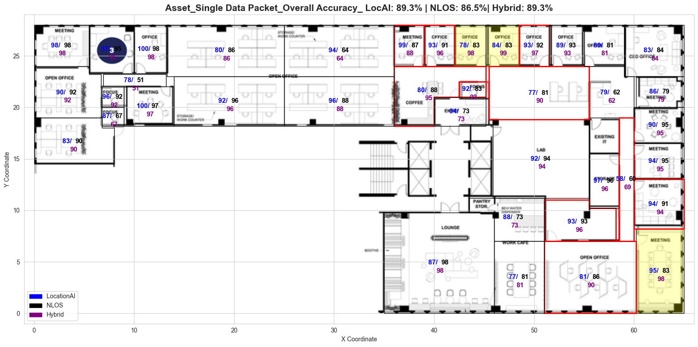
Asset_Cognosos_Normal Case
* The result based on 39 zones in total (18 Open Spaces + 21 Rooms)

Slide 4
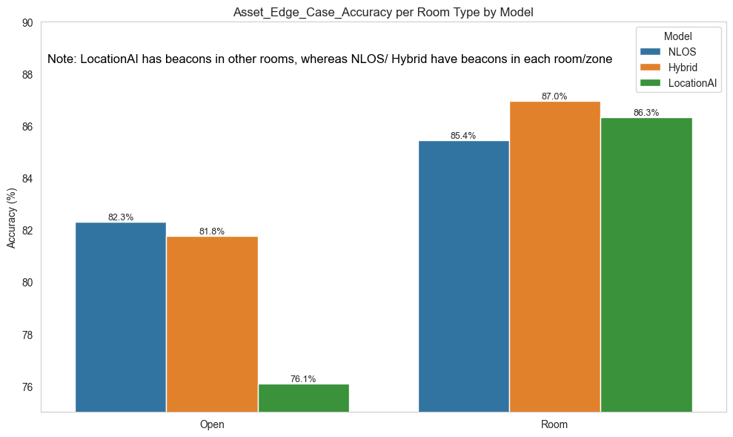
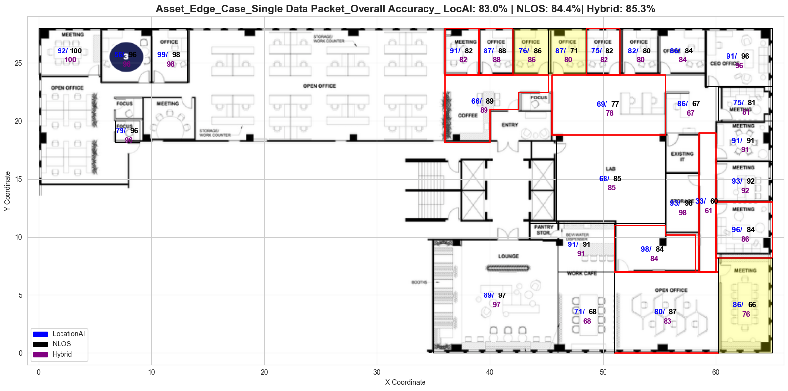
Asset_ Cognosos_ Edge Cases
This aims to test edge cases with 8 tags placed randomly in challenging locations, such as zone boundaries, shelves, or under tables
As a result, both Location AI and NLOS performance suffered.
Tag
* The result based on 28 zones in total (10 Open Spaces + 18 Rooms)

Slide 5
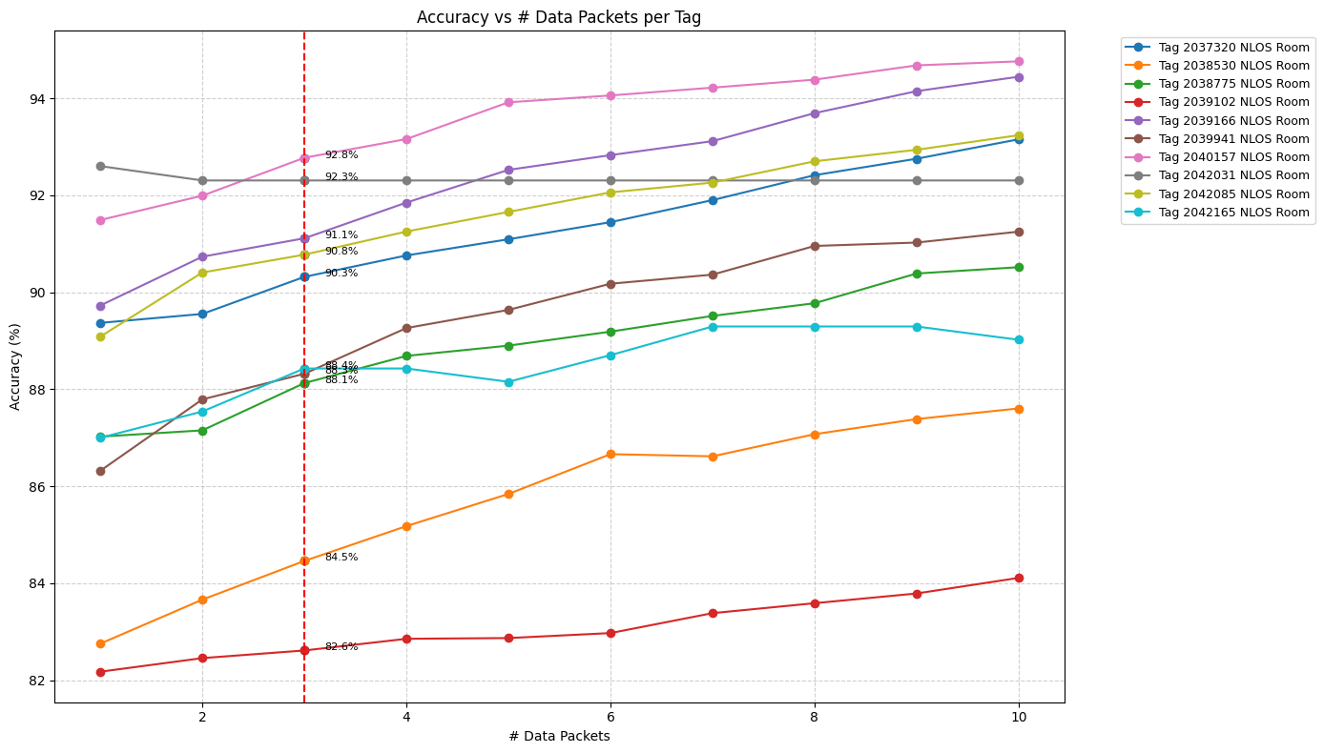
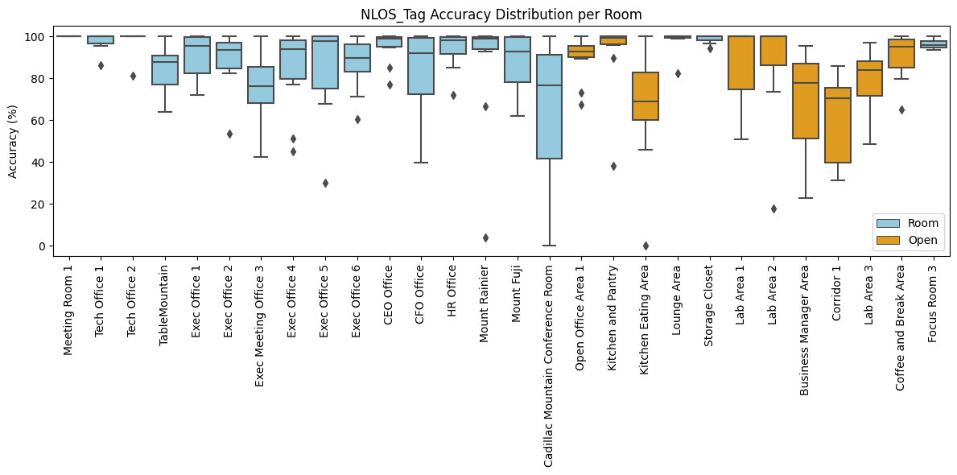
Asset_ Cognosos_ Edge Cases
Accuracy was highly dependent on tag placement, ranging from 82 % to 93 % at the room level.

Slide 6
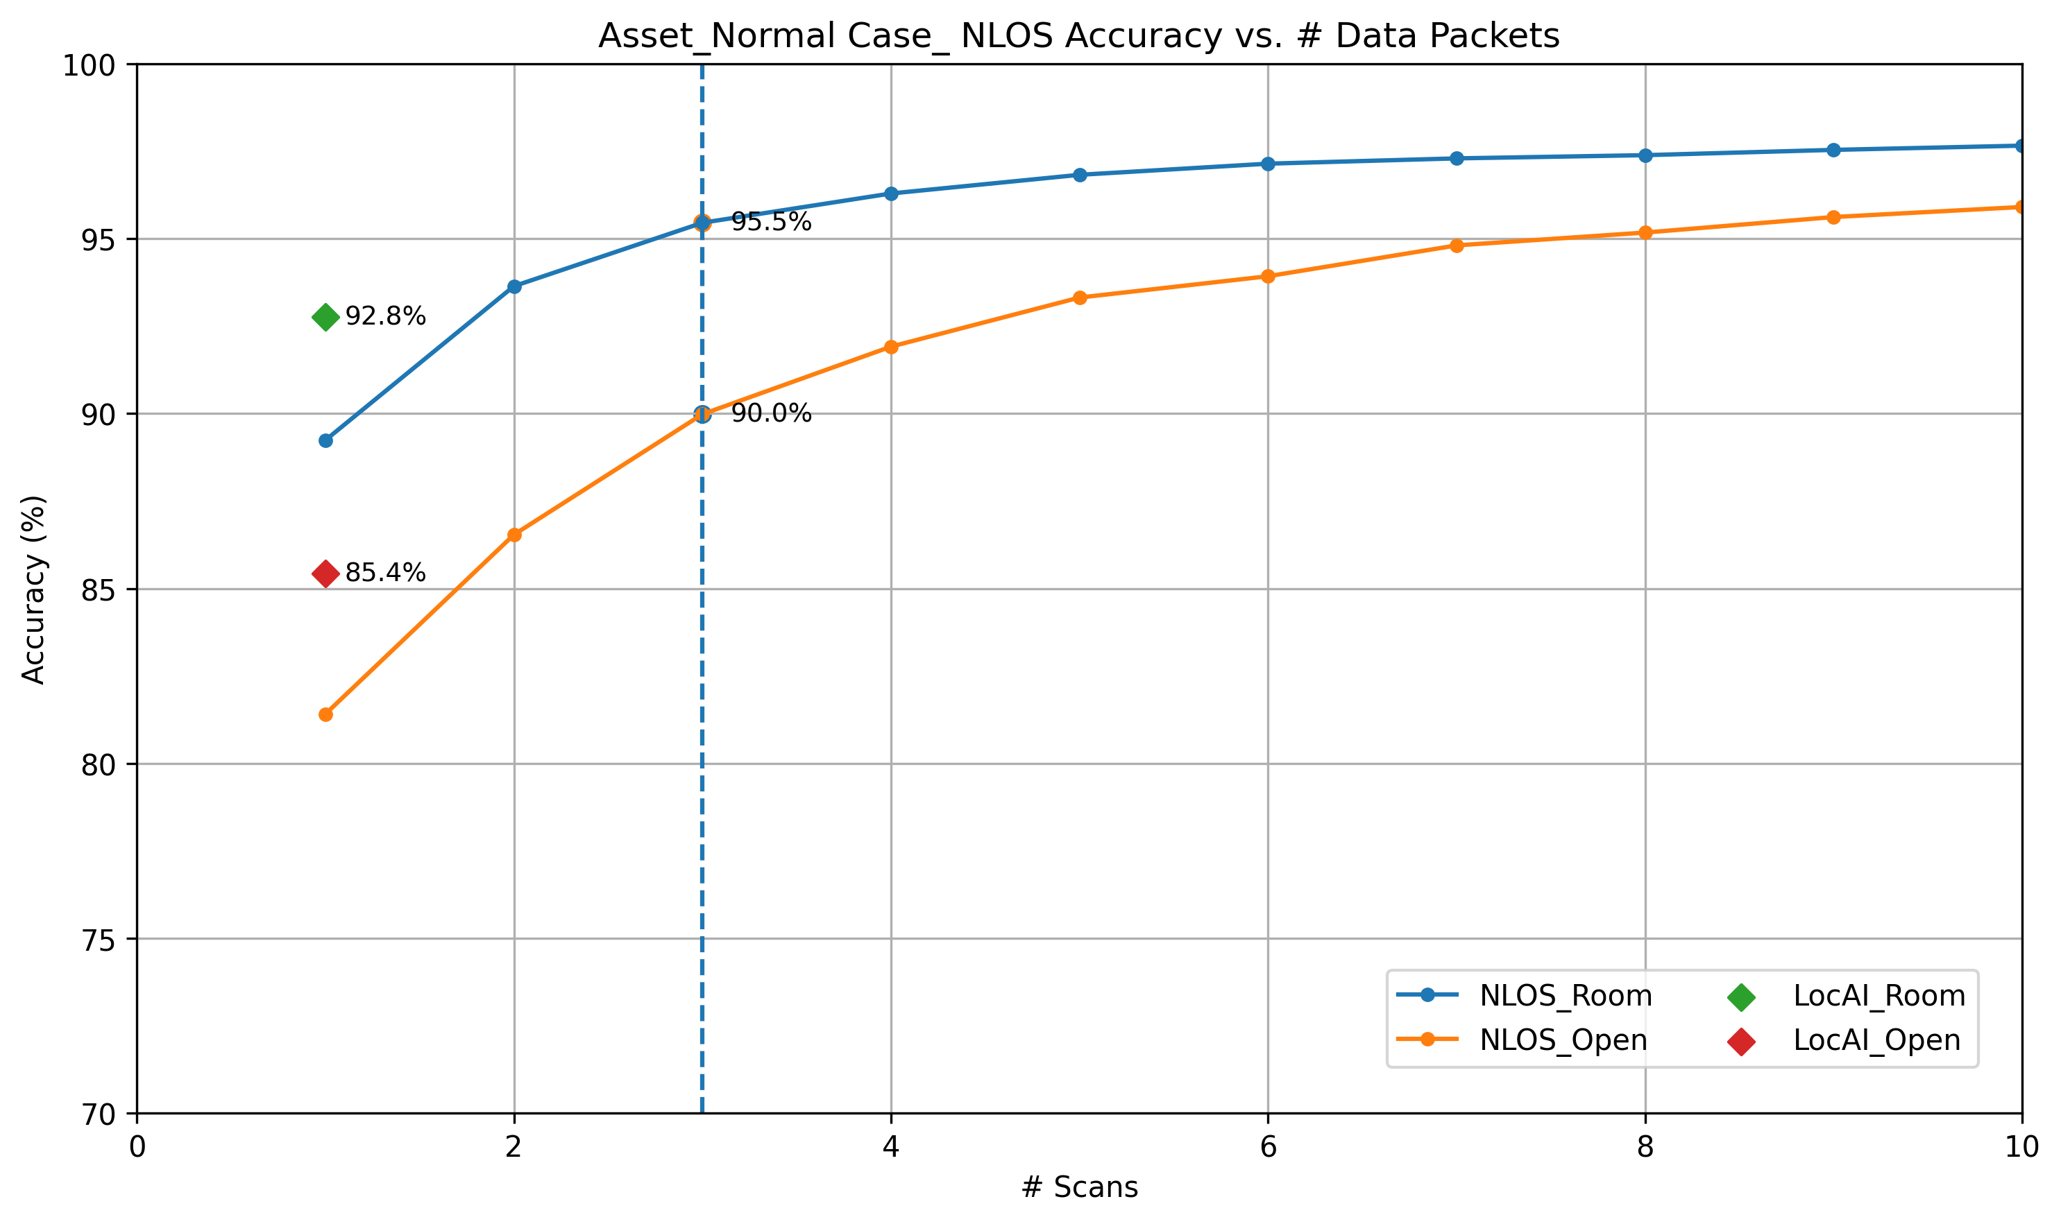
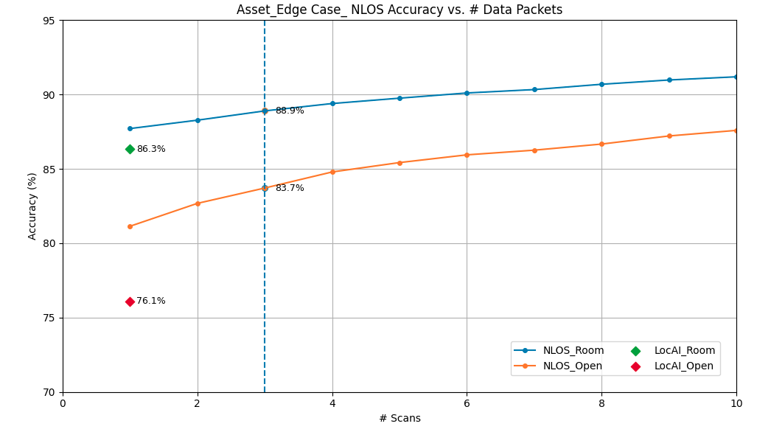
Asset Accuracy vs. Number of Scans

Slide 7
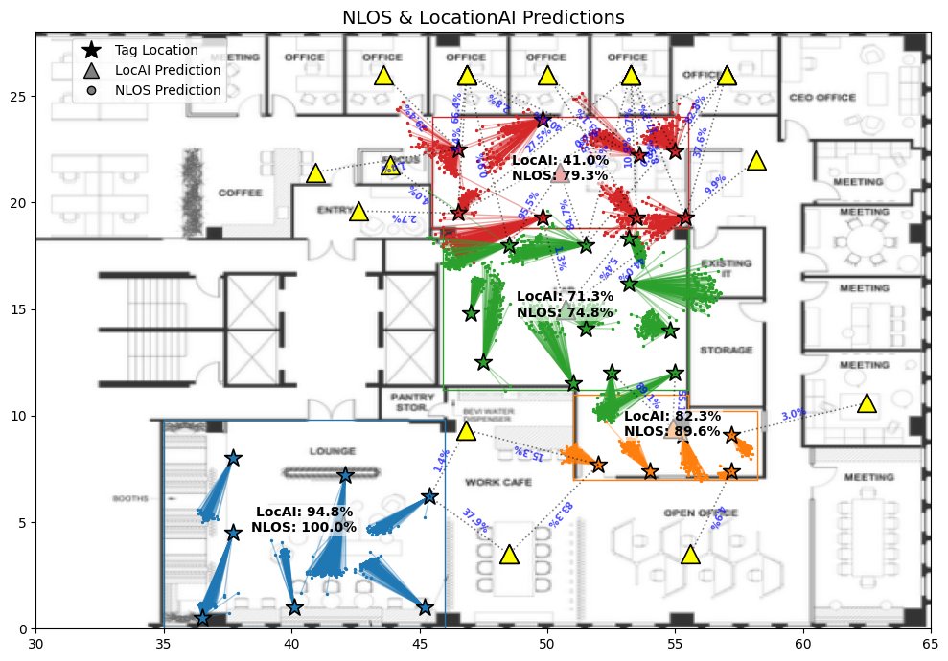
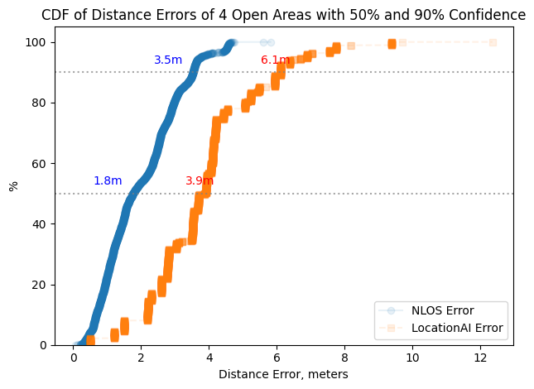
Asset_ Cognosos_ Open Area
Four open areas were tested, with eight tags per area with known tag locations.
Although the accuracy may vary, the distance error between the true tag location and the predicted zone location is significantly smaller for the NLOS-based method than for the Location AI approach. This is because Location AI relies on the centroid of the zone, whereas the NLOS prediction is derived directly from the coordinator.

Slide 8
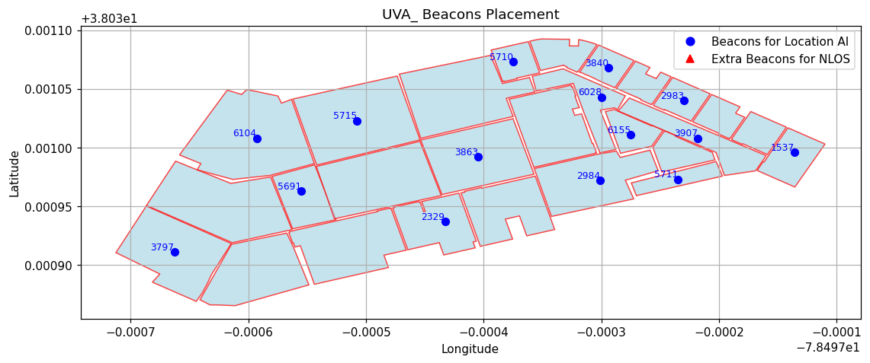
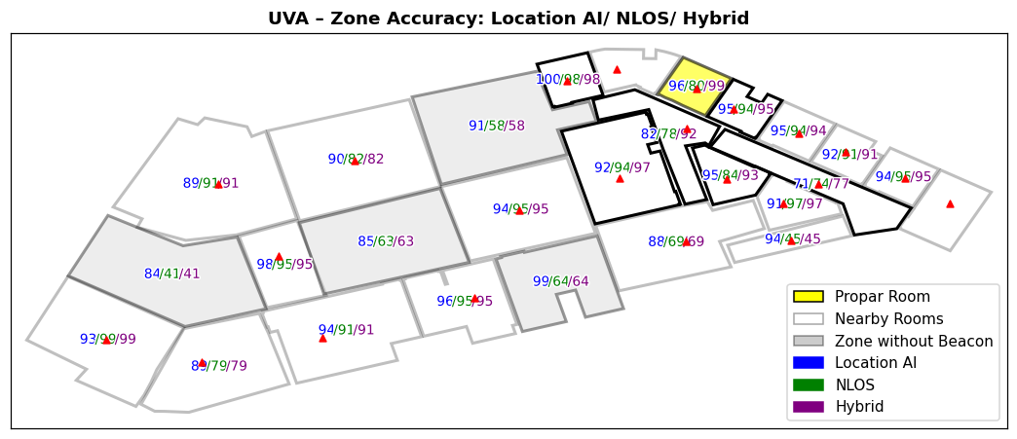
Asset_ UVA
The lower accuracy at UVA compared to the office is due to:
Four zones having no beacons (shaded zones).
A small area with limited beacon density have been tested, which leads to a lack of anchor points at the periphery which causes the predictions to be pulled to one side.
* The result based on 25 zones in total (12 Open Spaces + 13 Rooms)

Slide 9
Duress_ Cognosos
 | Scenarios | Algorithms | Single Scan |  | 5 Scans
 |  |  | Room | Open Areas | Room | Open Areas
Normal Case | Walking around normally | NLOS | 76 % | 71 % | 89 % | 88 %
 |  | LocAI | 86 % | 79 % | 94 % | 90 %
Edge Case | Walking normally, with the occasional hideout under the desk | NLOS | 73 % | 79 % | 76 % | 80 %
 |  | LocAI | 76 % | 83 % | 81 % | 87 %

Slide 10
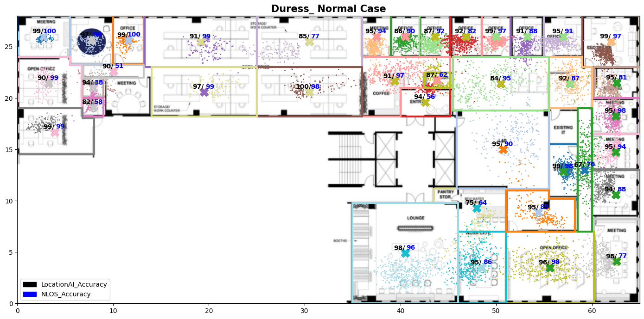
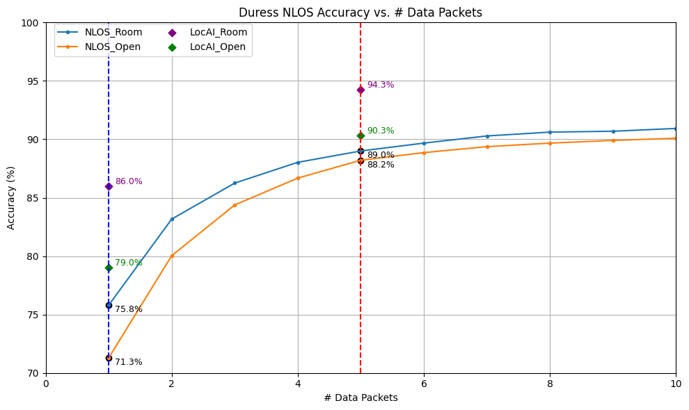
Duress_ Normal Case

Slide 11
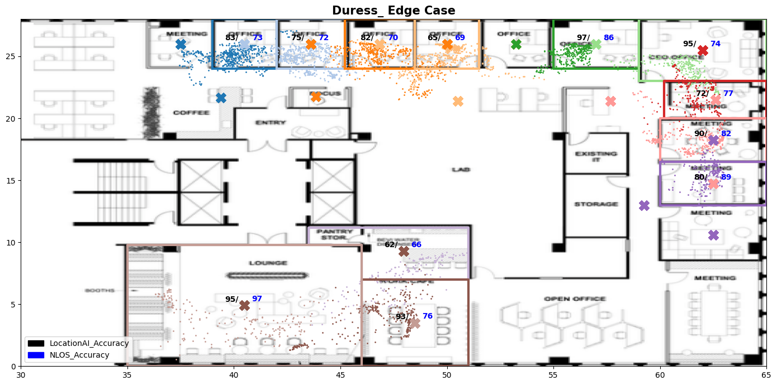
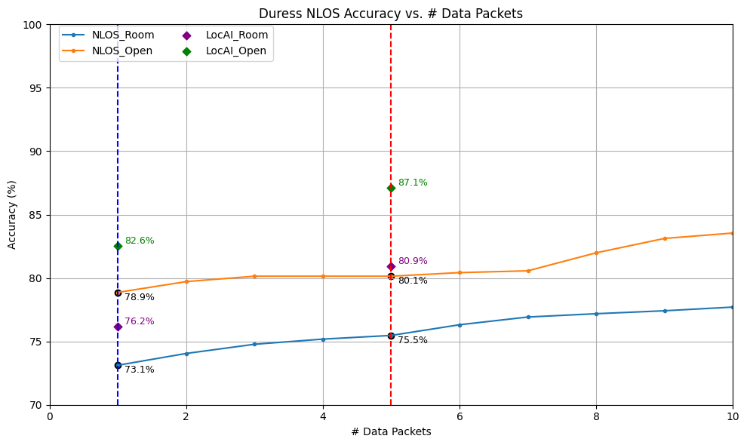
Duress_ Edge Case

Slide 12
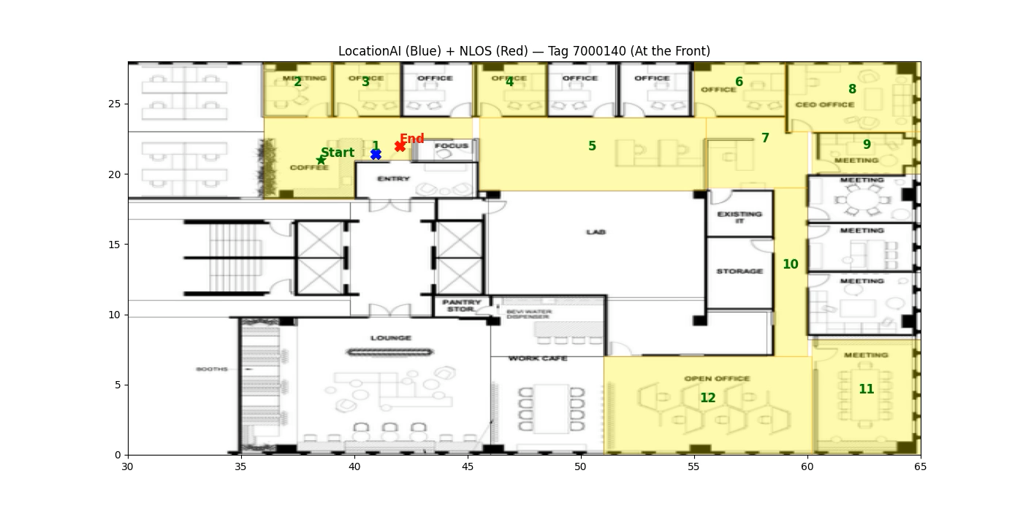
Duress Accuracy_ Movings Tags

Slide 13
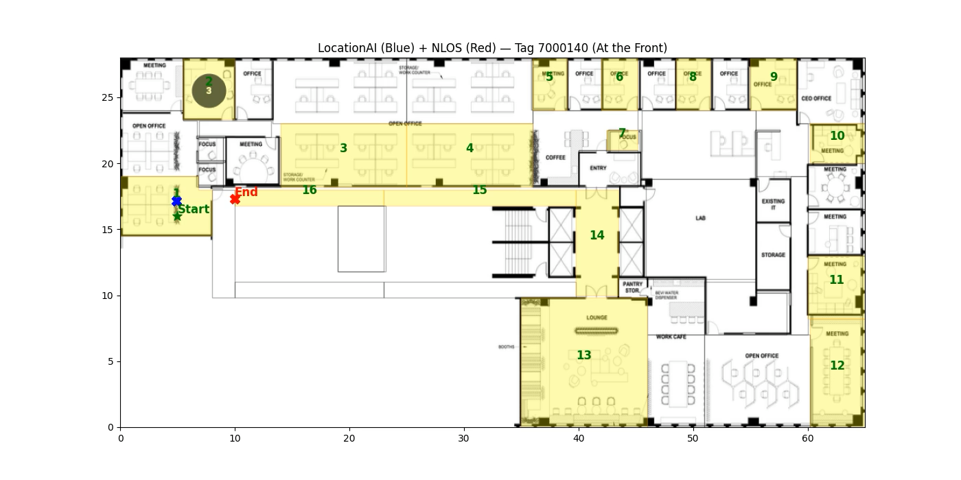
Duress Accuracy_ Movings Tags

